Slide 1
CS466 Chapter 4
Interrupt Basics

Slide 2
Interrupt…
Interrupts start with an input from the hardware, usually an interrupt request is asserted by some hardware which needs service. This device normally asserts the interrupt request line or IRQ on the microprocessor.
Can be generated by hardware or software.
Software interrupts are sometimes called exceptions
On microcontrollers, Most interrupts come from;
Internal controller Blocks
External GPIO’s

Slide 3
Interrupt Basics…
Interrupts can be level or edge (pulse) triggered
Level-Triggered interrupts will require that the triggering device lower its interrupt signal during the interrupt service or it will quickly re-enter.
Edge-Triggered interrupts need not be reset.
Which is easier to use?
Which is faster?
Which is easier to share?

Slide 4
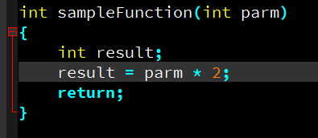
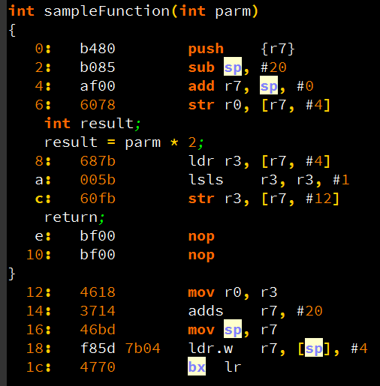
Function Basics, C vs. Assy…
arm-none-eabi-objdump -S gcc/blinkyRtos.o > blinkyRtos.s

Slide 5
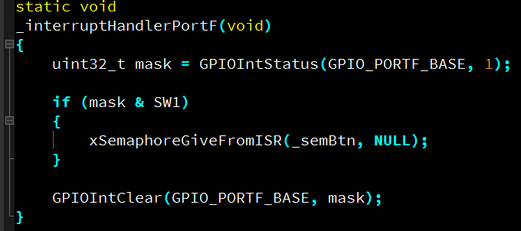
Interrupt Basics… C vs. Assy…

Slide 6
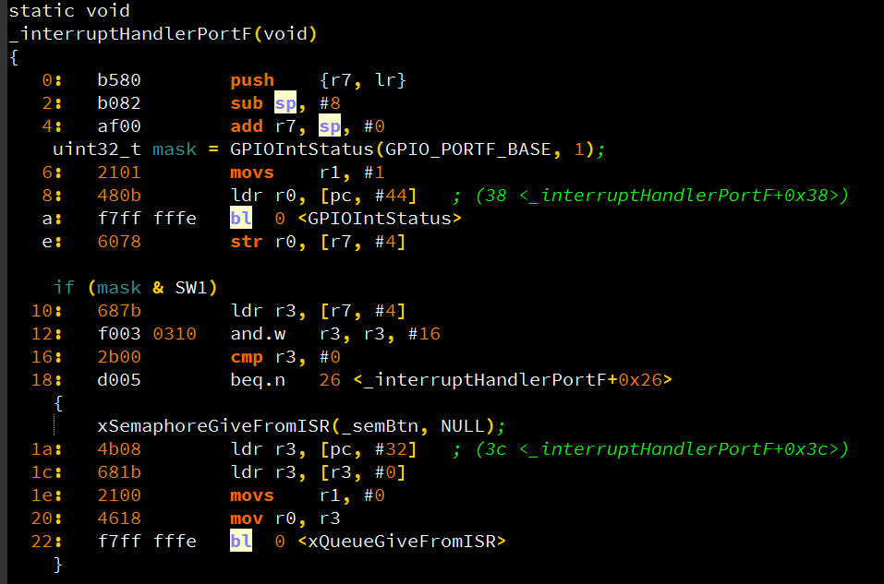
Interrupt Basics… C vs. Assy…

Slide 7
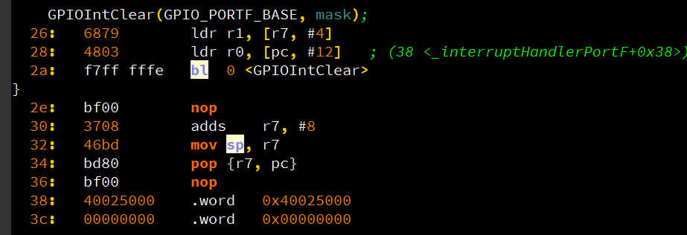
Interrupt Basics…

Slide 8
Typical ISR (Interrupt Service Routine)
Task Code Interrupt Routine
…
MOVE R1, (iCentigrade)
MULTIPLY R1, 9 Save Processor Context (Return Address, Flags, PSR)
DIVIDE R1, 5 PUSH R1
ADD R1,32 PUSH R2
MOVE (iFarnht), R1 …
JCOND ZERO, 109A3 !! read char from hw into R1
JUMP 14403 !! Store R1 value into memory
MOVE R5,23 …
PUSH R5 !! Reset serial port hw
CALL Skiddo !! Reset interrupt hardware
POP R9 …
MOVE (Answer), R1 POP R2
RETURN POP R1
… I-RETURN Restores Processor Context

Slide 9
Saving and Restoring Context
Pushing all the registers at the beginning of an ISR and popping at the end is known as saving and restoring the context.
This is CRITICAL. Failing to do the above can cause troublesome bugs.
Compilers generally do this for us
If you are eeking out highest speed you will be doing things in assembly and responsible for preserving context of the pre-interrupt executing code.

Slide 10
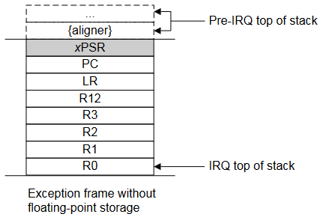
ARM Cortex M4 Exception Entry
When the processor takes an exception the processor pushes information onto the current stack. This operation is referred to as stacking and the structure of eight data words is referred as the stack frame.
Immediately after stacking, the stack pointer indicates the lowest address in the stack frame.
The stack frame includes the return address. This is the address of the next instruction in the interrupted program. This value is restored to the PC at exception return so that the interrupted program resumes.

Slide 11
ARM Cortex M4 Exception (cont)
In parallel to the stacking operation, the processor performs a vector fetch that reads the exception handler start address from the vector table. When stacking is complete, the processor starts executing the exception handler. At the same time
If no higher priority exception occurs during exception entry, the processor starts executing the exception handler and automatically changes the status of the corresponding pending interrupt to active.
If another higher priority exception occurs during exception entry, the processor starts executing the exception handler for this exception and does not change the pending status of the earlier exception. This is the late arrival case.
The ISR, executes and if it uses registers beyond those in the stack frame, It needs to push and eventually restore the registers before performing the interrupt return.
Generally the ISR will perform the handling for the interrupt and clear the interrupt in hardware.

Slide 12
ARM Cortex M4 Exception Return(cont)
Exception return occurs when the processor is in Handler mode and executes one of the following instructions to load the EXC_RETURN value into the PC:
an LDM or POP instruction that loads the PC
an LDR instruction with PC as the destination
a BX instruction using any register.

Slide 13
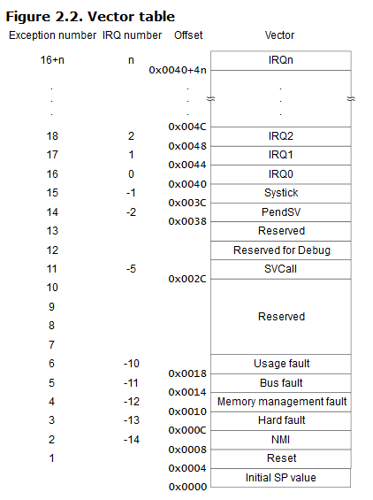

Slide 14
Pico Interrupt Entry Processing
Example for GPIO Source
GPIO Line configured to interrupt on edge
GPIO Signal driven active (Could be high or low)
GPIO block notifies ARM NVIC of GPIO block interrupt
ARM NVIC Notifies ARM Core of the Interrupt with Interrupt Number
ARM Core Completes execution of the current instruction
ARM Core Pushes Registers
(R0, R1, R2, R3, R12, LR, PC, and PSR)
More registers if Floating Point Processor (Not done in Pico)
Link Register is set to 0xFFFFFFE9
ISPR Register is set to show what interrupt will be running
ARM Core fetches ISR handler address from Vector Table
PC is updated with ISR Handler Address so next instruction is from handler.
The default interrupt ISR routine is used for all enabled interrupts. This routine is what calls runtime registered handlers thru the Pico SDK callback API.
If the Interrupts are disabled or the interrupt priority not high enough to disrupt a running interrupt the NVIC stores the interrupt request and it will take effect when priority and state allows

Slide 15
Startup and Linker File
pico-sdk/src/rp2_common/pico_standard_link/crt0.S
Vector table
weak definition if decl_isr
_reset_handler
Move .data to RAM
Zero .bss
Call Main
__StackTop
.pico-sdk/src/rp2_common/pico_standard_link/memmap_default.ld
MEMORY Definition
Sections get added to Memory Partitions
ELF _entry_point vs. _reset_handler

Slide 16
4.3 The Shared-Data Problem
As soon as we use interrupts, a shared data problem arises.
Guidelines of perhaps 10% maximum of CPU cycles in ISR’s are sometimes given. This is to increase responsiveness. But it’s a guideline…
Therefore, we are driven to perform as much work as possible at the task level and we generally use isrs to signal a task that there is work to do.
Therefore, isr’s and tasks must share common data.

Slide 17
Fig 4.4 Shared-Data (cont)
static int iTemperatures[2]; // global to task and isr
void interrupt vReadTemperatures(void)
{
iTemperatures[0] = !! read in value from hw
iTemperatures[1] = !! read in value from hw
}
void main(void)
{
int iTemp0, iTemp1;
while(TRUE)
{
iTemp0 = iTemperatures[0];
iTemp1 = iTemperatures[1];
if(iTemp0 != iTemp1)
!! Set off howling alarm;
}
}

Slide 18
Fig 4.5 Harder Shared Data Problem
static int iTemperatures[2];
void interrupt vReadTemperatures(void)
{
iTemperatures[0] = !! read in value from hardware
iTemperatures[1] = !! read in value from hardware
}
void main(void)
{
while(TRUE)
{
if(iTemperatures[0] != iTemperatures[1])
!! Set off howling alarm
}
}

Slide 19
Assembly language if-equal
.
.
MOVE R1, (iTemperatures[0])
MOVE R2, (iTemperatures[1])
SUBTRACT R1,R2
JCOND ZERO, TEMPERATURES_OK
.
. Code goes here to set off the alarm…
.
TEMPERATURES_OK:

Slide 20
Characteristics of the shared data bug
The iTemperatures[] array is shared between the interrupt routine and the task code.
These are fiendish bugs…all works ok unless the interrupt just happens to occur in a small window of vulnerability.
5:00 on Friday afternoon
Any time you are not working on it
Whenever no debugging tools/equip attached
After landing on Mars
During Customer Demos

Slide 21
Atomic vs. Critical
A part of a program is said to be atomic if it cannot be interrupted.
The shared data problem arises in part because the task code uses the data in a way that is not atomic.
A set of instructions that must be atomic for the system to perform correctly is called a critical section.
If you are lucky enough to be using a modern C++ compiler you can say
static std::atomic<int> _value = func();

Slide 22
Is Disabling Interrupts OK?
Interrupt Priority Levels
Non-Maskable Interrrupts
Critical Regions of Code
Atomicity
Effect on other ISR’s Tasks
Team/Project Good Citizinship
Does it scale?

Slide 23
Solving the Shared Data Prob
Disable Interrupts whenever the task code uses the shared data…
Brutal and heavy handed, may have a large effect on overall project operation
Protect with an atomic variable
Sloppy, does not scale well, and ISR integrity may require updates skipped.
Protect shared data memory with semaphore
may not work as ISR’s cannot block
Use FreeRTOS Queues to transfer data to task space from ISR space
Best solution
Scales well
Least timing effect on other tasks.
Will port to most other RTOS environments as it’s a common paradigm
No C compilers or assemblers are smart enough to figure out when to disable or enable the interrupts!

Slide 24
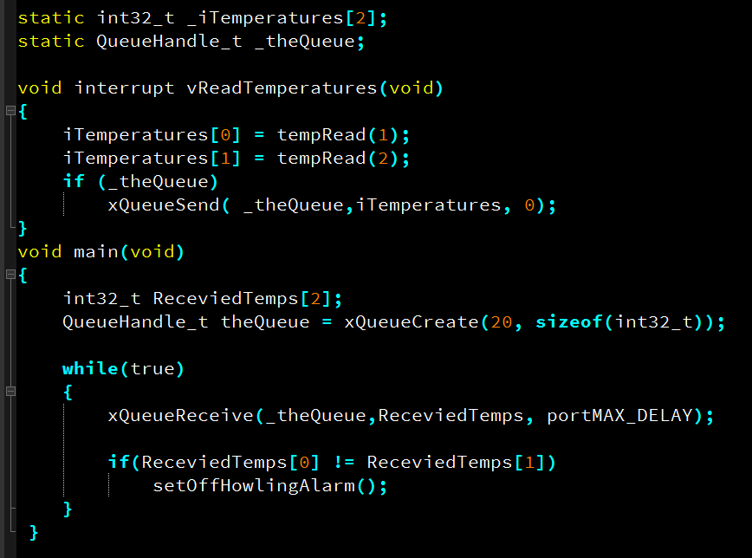
The Way I Would Solve It
What is the error on this page? (Discovered Late)

Slide 25
Interrupt Latency
Interrupts are a tool for getting better response from our system
The speed of response of an embedded system is always of interest
The term interrupt latency refers to the amount of time that it takes a system to respond to an interrupt.

Slide 26
Interrupt latency (cont)
The following are contributing factors:
The longest period of time during which that interrupt is (or all interrupts are) disabled.
The period of time that it takes to execute any interrupt routines for interrupts that are of higher priority than the one in question.
How long it takes the microprocessor to stop what it is doing, do the necessary bookkeeping, and start executing instructions in the interrupt routine.
How long it takes the interrupt routine to save the context and then do enough work to count as a response.

Slide 27
The volatile keyword
Is a storage declarator
What are some other storage declarator keywords
Can I have a volatile struct?
When we allow the compiler to optimize, it makes the assumption that values stay in memory until the program changes it. This can and does cause problems.
The compiler can optimize out certain assignments logically…talk about this.
Declare keywords volatile to warn the compiler that an identifier may be changed with it not knowing…

